Slide 1
Predicting Metacritic Review Scores
Capstone Project 1

Slide 2
The 411 on the Video Games Industry
The video game industry continues to grow in popularity across the globe. There are more games now more than ever!
One way games can differeniate themselves from the pack is earning a High Metacritic Score.
Metacritic is website millions of consumers visit per day to view the best-reviewed games. Metacritic review score offers a way to gain notoriety in the mind of video game consumers.

Slide 3
The Issue with Metacritic Scores
Metacritic Score only come out after it too late to make crucial changes that could have dramatic impact on Critic scores.
If executives had a model that would let them know how critics will judge their games, it could provide critical insight. For example if you know that a game will be rated poorly before the release, you could delay the game to make crucial changes in an effort to increase the score.
with a higher Metacritic score comes higher notoriety and increased sales potential.

Slide 4
Data Wrangling
I began my analysis with a dataset available from Kaggle found at the following link: “https://www.kaggle.com/rush4ratio/video-game-sales-with-ratings/data”.
Next, I removed unnecessary information(ie. sales data) and video games released before 2012.
The data set contains some missing values in ‘Ratings’ column so I filled the missing values with the most common rating in the data set ‘E’.

Slide 5
Exploratory Data Analysis
Critic score can vary by Genre
Puzzle Games are a safe bet (high score and low variance)
Action Games are the most popular genre of game within the data set.
Major Developer tend to create games with higher critic scores.
Mature Rated Games tend to be rated higher but have the highest variance.
The more critics the better!

Slide 6
Feature Selection
The data set contains 16 different features columns most were categorical columns. To create the best model, we need to find the feature that have a statistically significant relationship with critic score.
Using hypothesis testing, I verified that Critic count, Genre, Developer size, and Rating are statistically significant when trying to predict critic score.

Slide 7
Model Construction
1st Model(Linear Regression) we tried to use liner regression model using all the statistically significant variables in the data set.
2nd Model(random forest regressor) offered a better results but no significant increase in predictive power.
R-Squared on Test set : .49
3rd Model (classification model) worked well when predicting on the label of game (poor, average, good, great)

Slide 8
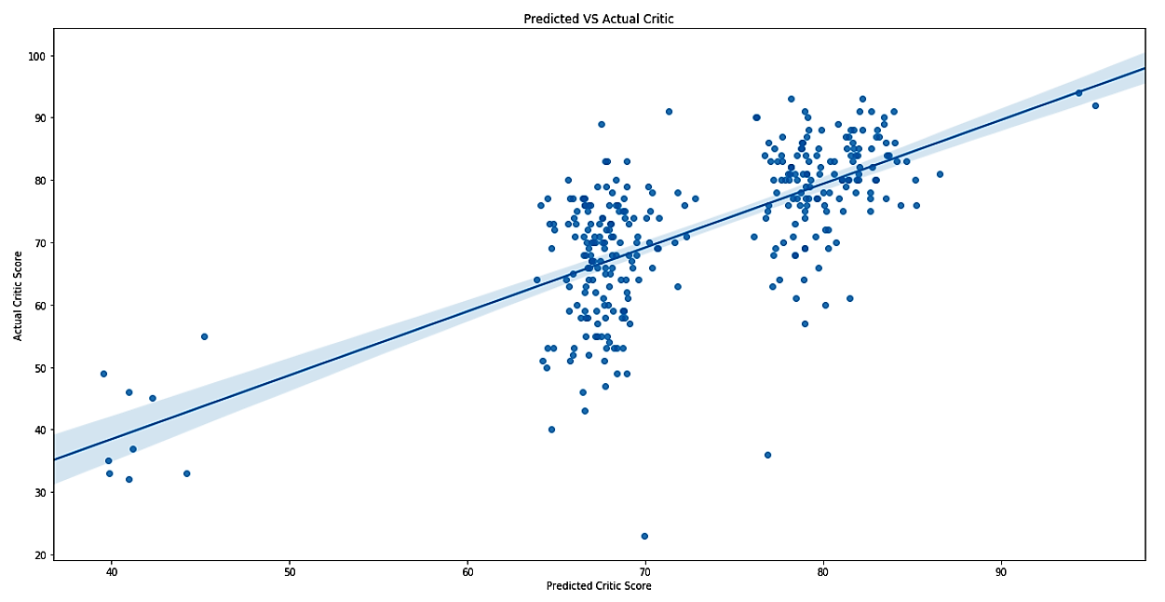
Predicted Vs Actual from the test set

Slide 9
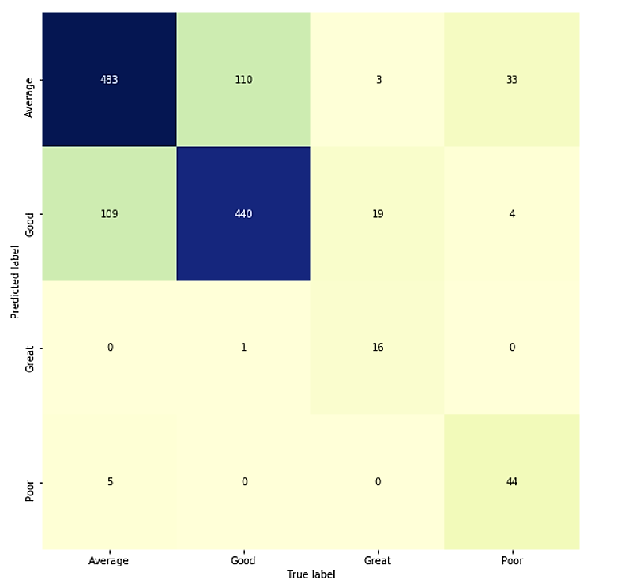
True labels vs Predicted labels

Slide 10
Model Construction cont.
3rd Model – predict the Category the critic score would fall into.
Categories: Poor, Average, Good, and Great
The model was significantly more accurate than the linear regression model.
R-Squared: 0.78

Slide 11
Model Construction cont.
3rd Model – predict the Category the critic score would fall into.
Categories: Poor, Average, Good, and Great
The model was significantly more accurate than the linear regression model.
R-Squared: 0.78

Slide 12
Crucial Insights
We need more information on game feature.
Example: Online Multiplayer?
Developer’s median scores are strong predictors of critic score.
If a developer has a history of producing ‘Great’ games, the next game’s critic score should be some where close to their last game.
The more critics involved in the calculation of Metacritic scores the better.
We don't have enough information to predict exact critic score but we can predict which category the score should fall into.
The classification model will provide enough insight to make business decisions.

